Slide 1
Abbulu - Capstone Project The Battle of Neighborhoods Final Presentation - Summary

Slide 2
What Business Problem have I attempted to solve? Many people move to a new city, during their lifetime, isn’t it good to know about the neighborhoods of that place before going there? Like the neighborhood has a variety of Coffee shops, Restaurants, Entertainment places, Parks, etc. That’s the idea I wanted to explore in this project. I believe this would be useful to a casual person as well as any one seriously considering moving to San Francisco or Seattle. It can be used to compare neighborhoods in both of these cities. It would help new student graduates, mid-career professionals who want to move to a new city for better job opportunities and immigrants who would like to compare cities before actually emigrate.

Slide 3
How I did it? 1. Gathered neighborhood data for San Francisco and Seattle from Wikipedia. 2. Then used Geolocator to get latitude & longitude for each of the neighborhoods. 3. Then used Four Square API to, a. get all venues within a 500 meter radius. b. get category of each venue. c. get venues details d. get count of venues for each neighborhood e. get top 5 most and top 10 venues in each neighborhood 4. Created clusters of neighborhoods using to k-means clustering algorithm 5. Then examined each cluster and determine the discriminating top 10 venue categories that distinguish each cluster.

Slide 4
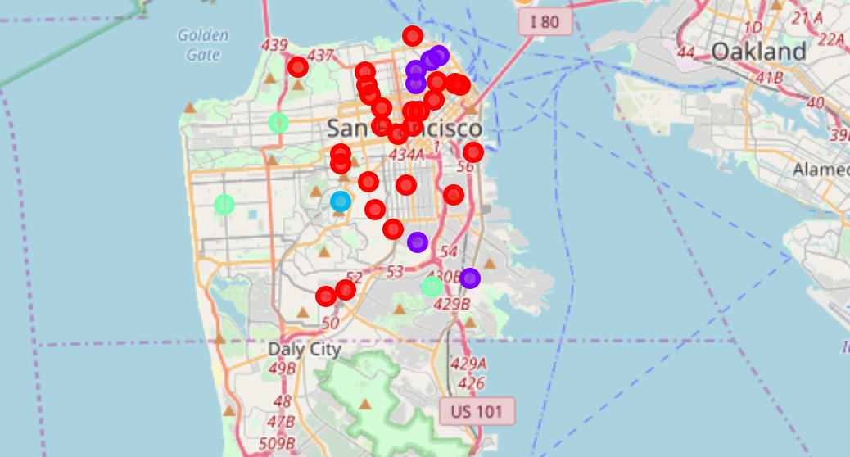
What I found in San Francisco? San Francisco can be grouped into two main clusters Cluster 1: Consists of 25 neighborhoods and the distinguishing characteristics are Coffee shops, Bakeries, Restaurants, and Bars. It’s not surprising young professionals love to live in these neighborhoods. Cluster 2: Consists of 6 neighborhoods and the top distinguishing characteristic is they all have Italian Restaurant at #1 most visited place.

Slide 5
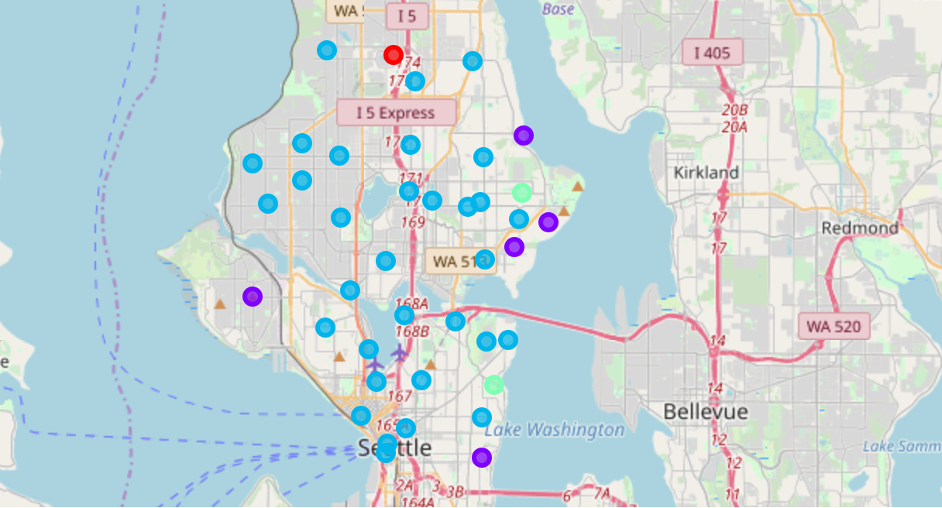
What I found in Seattle? Seattle neighborhoods can be grouped into two main clusters Cluster 1: Consists of 36 neighborhoods and the distinguishing characteristics are Coffee shops, Sandwich shops, Restaurants, and Bars. Few Grocery stores are in the top 1 venues most visited here. Cluster 2: Consists of 6 neighborhoods and has several parks and some restaurants

Slide 6
What I learned? 1. Practiced more Python and learned some more. 2. Learned scrapping data from a website 3. Used Geolocator to get latitude and longitude for an address 4. Used Four Square API to get venue details 5. Used k-means clustering algorithm to cluster neighborhoods Thank you for reading this.

